Slide 1


Comprehensive Website Analytics Presentation
Web analytics, visualization, dashboards, ethics, and Q&A
By Kevin McMahon
Notes:
This presentation introduces how web analytics helps organizations understand user behavior, evaluate performance, and make informed decisions. The goal is to explain key analytics concepts in a clearway for both a business and technical audience.
We will walk through how data is collected and visualized, why dashboards matter, and how analytics tools support strategy, growth, and accountability. We will also address challenges related to big data, privacy, and ethical use, which are critical in today’s digital environment.
By the end of this presentation, the audience should have a solid understanding of how web analytics drives smarter decisions, improves user experiences, and supports long term business value

Slide 2
Agenda
Why web analytics matters and how it supports decisions
Big Data challenges, solutions, and real-world examples
Tool rating chart with a color key
Data use policies, privacy, and data ownership
Audience Q&A with prepared answers and contact info
Notes:
We will begin by explaining why web analytics matters and how it supports real business decisions, not just reporting.
Next, we will cover big data challenges, including how large volumes of data are collected, managed, and turned into usable insights through real examples.
We will then review popular web analytics tools using a rating chart with a color key to compare features and usability. After that, we will discuss data use policies, focusing on privacy, responsible data handling, and ownership.
Finally, we will close with a Q&A section that addresses common audience questions and provides contact information for follow-up.

Slide 3
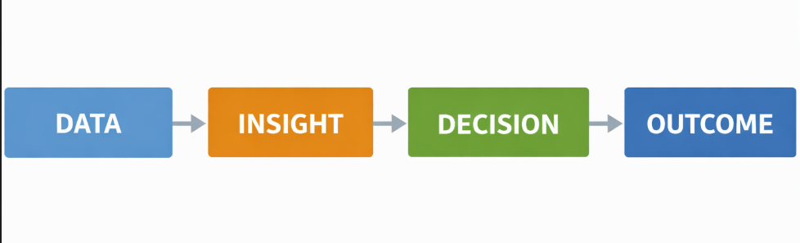
Why Web Analytics Matters Right Now
Digital behavior changes fast, analytics shows what is actually happening
Teams use metrics to prioritize content, features, and marketing spend
Measurement reduces guesswork and improves accountability
Strong analytics helps align product, creative, and revenue goals
Notes:
Web analytics builds on the agenda we just reviewed by showing how data moves from observation to action. Instead of relying on assumptions, teams can see what users are actually doing in real time.
Because digital behavior changes quickly, analytics helps organizations stay grounded in current user activity. Metrics make it easier to prioritize content, product updates, and marketing spend based on evidence rather than opinion.
When measurement is consistent, guesswork is reduced and accountability improves. Strong analytics also helps align product, creative, and revenue goals so decisions support clear, measurable outcomes.

Slide 4

From Metrics to Decisions
Content decisions: what to publish more of and what to retire
UX decisions: where users drop off and what to fix first
Growth decisions: which channels drive valuable traffic
Revenue decisions: which segments and formats monetize best
Notes:
Building on why analytics matters, this is where the numbers start to turn into real choices.
Metrics help teams decide what content to double down on and what no longer serves the audience. When users drop off at a specific point, analytics highlights where the experience needs attention instead of guessing.
Growth decisions become clearer by showing which channels actually bring engaged users, not just traffic volume. Revenue decisions also improve because performance data reveals which formats and audience segments convert most effectively.
At this stage, analytics is no longer about reporting. It becomes a guide for prioritizing effort, budget, and strategy based on how users truly behave.

Slide 5
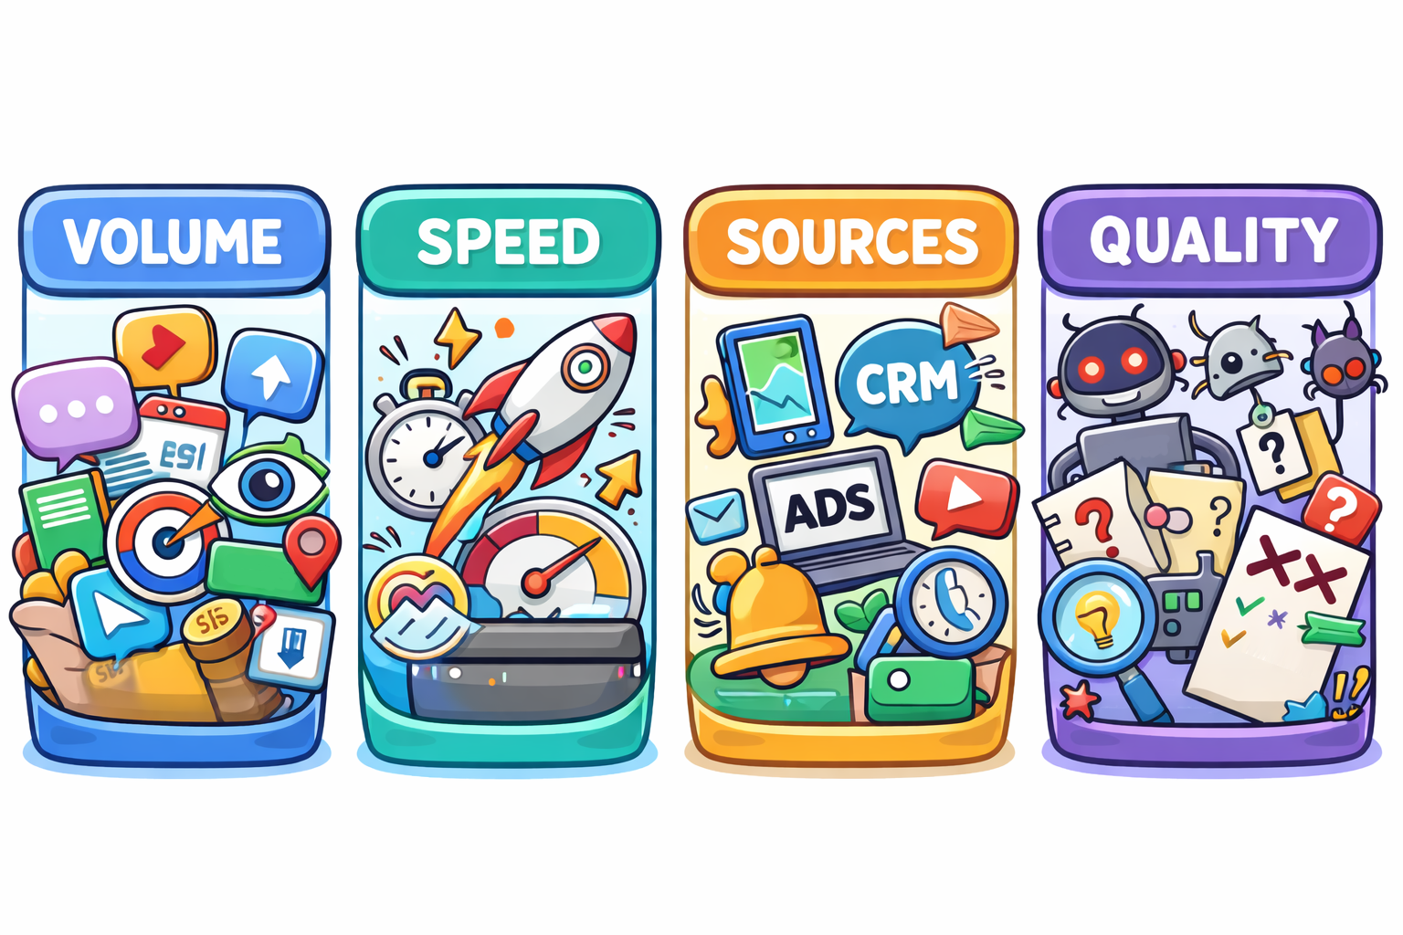
Big Data in Web Analytics
High volume: events, clicks, views, and logs add up quickly
High speed: data arrives continuously and needs fast processing
Many sources: web, app, ads, CRM, subscriptions, and support tools
Quality issues: bots, missing tags, sampling, and inconsistent definitions
Notes:
As we move deeper into how analytics works in practice, it helps to understand why it is often treated as Big Data.
Even a single website or platform can generate massive volumes of information. Every click, view, scroll, and interaction adds another event to track, and those events stack up quickly. At the same time, this data arrives continuously, which means it has to be processed fast enough to stay useful for decision making.
The challenge grows as data comes from many places. Web activity, mobile apps, advertising platforms, CRM systems, subscriptions, and support tools all feed into analytics. Bringing those sources together is powerful, but it also introduces risk when definitions or tracking rules are not consistent.
Quality becomes the final pressure point. Bots, missing tags, sampling, or unclear metric definitions can distort results. If the data quality is weak, even well designed dashboards can point teams in the wrong direction. This is why strong analytics practices focus as much on data reliability as they do on visual presentation.

Slide 6
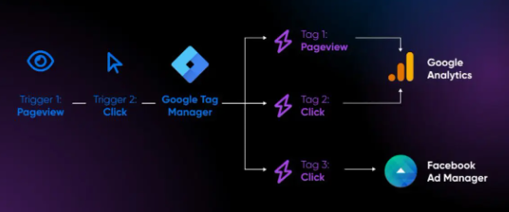
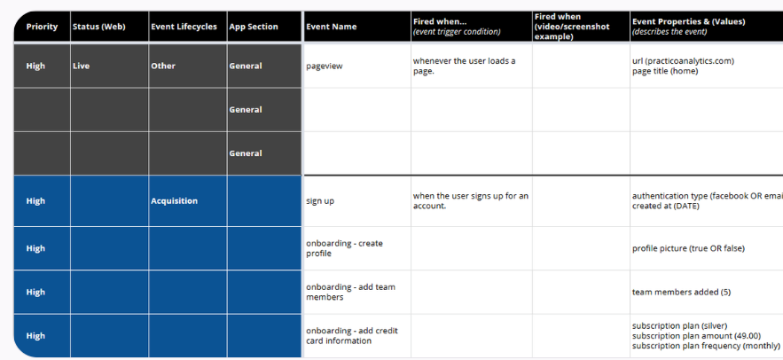
Challenge: Data Collection
Tracking plan gaps lead to missing events and incomplete stories
Tag issues cause double-counting or lost sessions
Cross-device behavior is hard to unify cleanly
Consent requirements change what can be collected
Notes:
Data collection is where analytics often breaks down first. If events are not defined and tracked correctly, the story the data tells becomes incomplete or misleading. Gaps in tracking plans can hide key user actions, while tag issues may create double counting or missing sessions. Tracking users across devices adds another layer of complexity, especially as privacy and consent rules limit what can be captured. Getting collection right is critical because every report and decision downstream depends on this foundation.

Slide 7
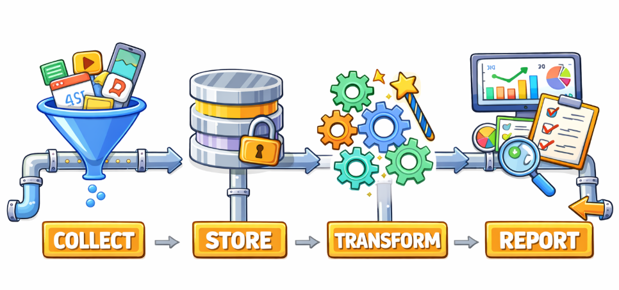
Challenge: Storage and Processing
Raw events must be stored reliably for audit and reprocessing
Pipelines must handle spikes without losing data
Transformations must be consistent and documented
Access controls are needed to prevent misuse
Notes:
Once data is collected, it has to be stored and processed correctly or the insights fall apart. Raw events need to be retained so teams can audit results and reprocess data when definitions change. Analytics pipelines also have to handle traffic spikes without dropping events. Just as important, transformations must be consistent and documented so metrics stay trustworthy over time. Because this data often includes sensitive behavioral signals, access controls are important to prevent misuse and protect the organization.

Slide 8
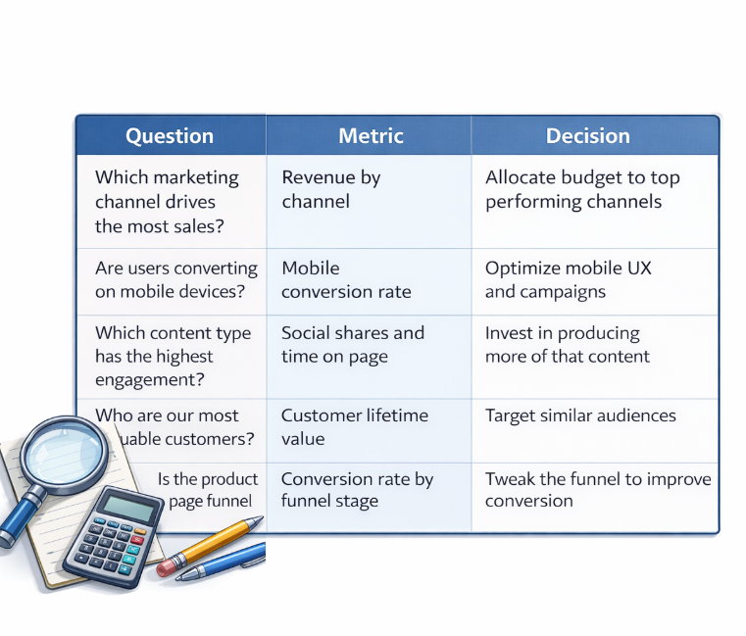
Challenge: Modeling and Actionable Insight
Metrics must match business questions, not vanity reporting
Attribution is complex when users return through different channels
Segment definitions must be stable across reports
Insight requires context like content type, audience, and intent
Notes:
Once data is processed, the real challenge is turning it into insight that actually drives action. Metrics need to answer real business questions, not just look good in a dashboard. Attribution becomes harder when users move across multiple channels, which is why consistent category definitions matter. Context is what turns numbers into the insights. Understanding content type, audience, and intent helps teams decide what to invest in, what to fix, and what to stop doing. The goal is always a clear next step, not just another metric on a report.

Slide 9
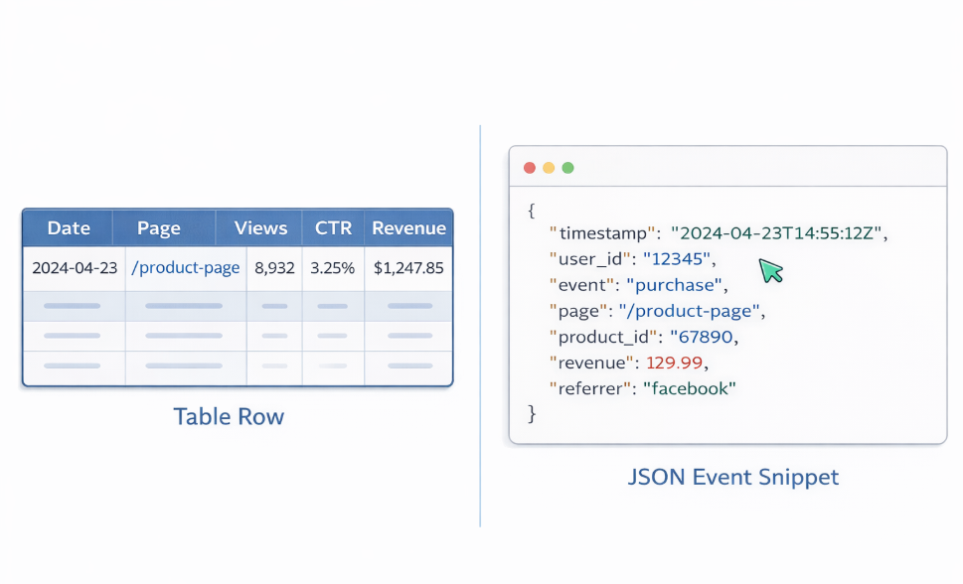
Web Analytics Data Formats
Structured: tables like views, CTR, revenue by day
Semi-structured: JSON events and tag payloads
Unstructured: text feedback, comments, and support tickets
Media data: thumbnails, watch segments, and retention curves
Notes:
Once we know what questions we want to answer, the next challenge is understanding the types of data we work with. Web analytics is not just clean tables. Some data is structured and easy to chart, like views, click-through rate, or revenue by day. Other data comes in semi-structured formats, such as JSON event payloads from tags and tracking tools. There is also unstructured data, like user comments or support tickets, which adds context but requires interpretation. Media data, like thumbnails and retention curves, adds another layer by showing how users actually engage. Each format requires different tools and handling to turn raw data into usable insight.

Slide 10

Joining Diverse Data Sources
Real World Examples:
Combine YouTube traffic source with watch time to find high-value channels
Join CTR by thumbnail with retention to detect clickbait risk
Connect revenue type with content categories to improve monetization strategy
Add posting schedule data to explain spikes and dips
Notes:
Once we understand the different data formats, the real value comes from combining them. Looking at one metric in isolation can be misleading, but joining sources adds context. For example, a traffic source may look strong by views alone, but pairing it with watch time or retention shows whether that traffic is actually valuable. High click-through rate combined with poor retention can signal clickbait or expectation mismatch. When revenue, content type, and posting timing are joined together, patterns start to explain why spikes and dips happen. This is where analytics moves from reporting numbers to explaining behavior and guiding smarter decisions.

Slide 11
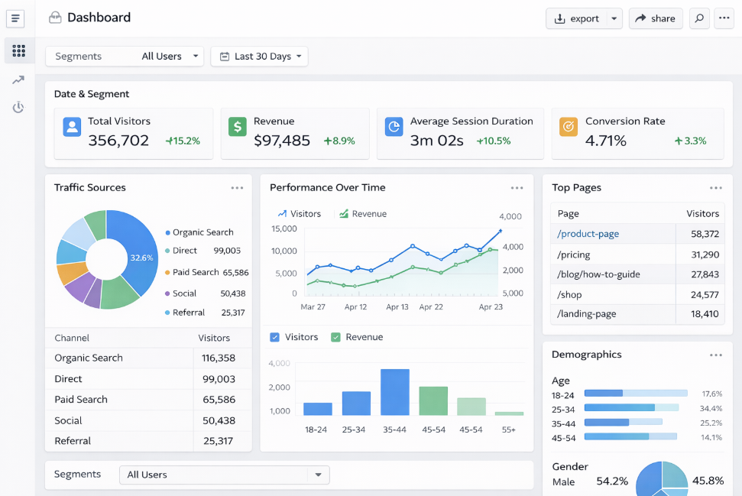
Dashboards: What Makes Them Useful
Clear hierarchy so the most important signals are seen first
Consistent definitions so metrics do not conflict across panels
Design choices that reduce confusion and bias
Enough context to act, including time range and segment
Notes:
Once data is joined and modeled, dashboards are where teams actually interact with the insights. A good dashboard is designed to answer questions quickly, not just display charts. The most important signals should be visible first, with consistent definitions so numbers do not contradict each other across panels. Design matters because clutter, poor color choices, or inconsistent scales can introduce bias or confusion. Context like time range and audience segment is critical, because without it, teams cannot confidently act on what they see. The goal is faster and better decisions with less guesswork.

Slide 12
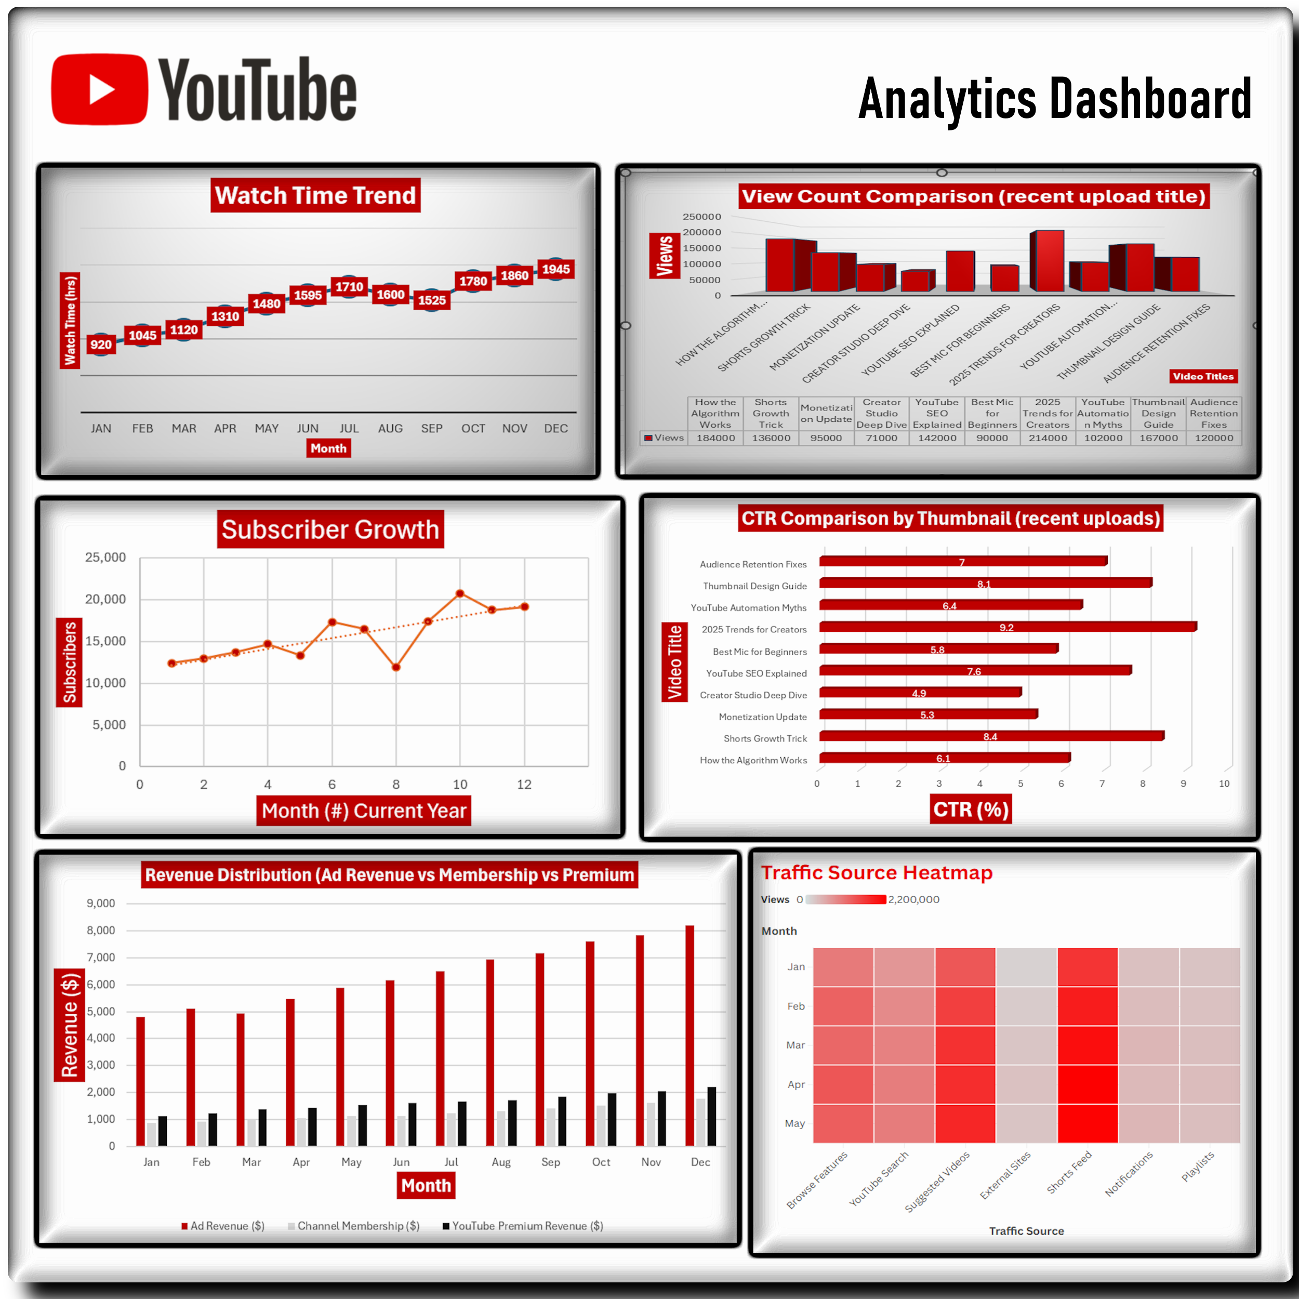
Example Dashboard: YouTube Channel Performance
Watch time trend highlights momentum and seasonality
View comparison shows which uploads are driving reach
Subscriber trend validates whether growth is sustained
Revenue distribution shows monetization mix over time
Notes:
Now we can see those dashboard principles applied in a real example. This YouTube channel dashboard pulls multiple metrics together so performance can be understood at a glance. Watch time trends reveal momentum and seasonality, helping identify when content is gaining or losing traction. View comparisons show which uploads are actually driving reach, not just impressions. Subscriber growth confirms whether that engagement is translating into sustained audience growth. Revenue distribution highlights how monetization is balanced across ads, memberships, and premium sources. Together, these views allow a quick scan to spot what is improving, what is slipping, and where action is needed next.

Slide 13
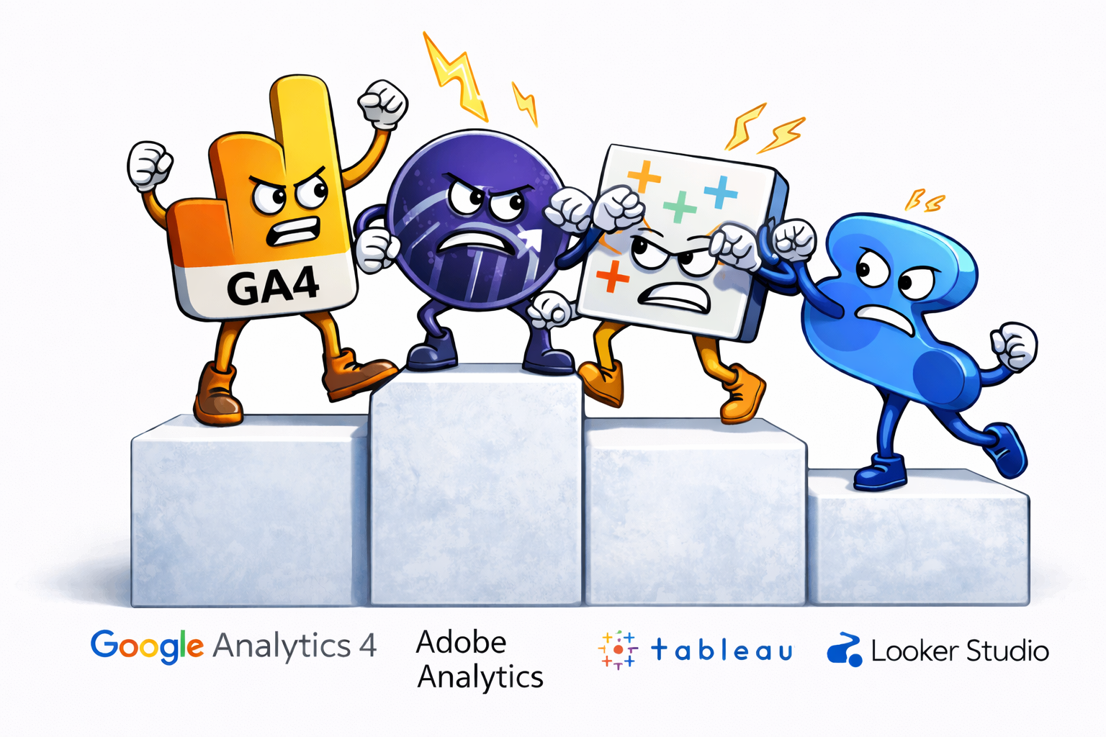
Tool Rating Chart: Popular Web Analytics Tools
Google Analytics 4: strong ecosystem and reporting depth
Adobe Analytics: enterprise level segmentation and analysis
Looker Studio: flexible dashboarding and sharing
Tableau: strong visual analytics and exploration
Notes:
After seeing how dashboards bring metrics together, the next question is which tools teams rely on to make this possible. Different platforms excel at different parts of the analytics workflow, so the goal is not to crown a single winner but to understand strengths and tradeoffs. Google Analytics 4 stands out for its tight ecosystem integration and reporting depth. Adobe Analytics is designed for large organizations that need advanced segmentation and complex analysis. Looker Studio focuses on flexible dashboards and easy sharing across teams. Tableau excels at visual exploration and uncovering patterns in complex datasets. These tools are rated based on the features that matter most to analytics teams and decision makers, which will be broken down on the next slide.

Slide 14
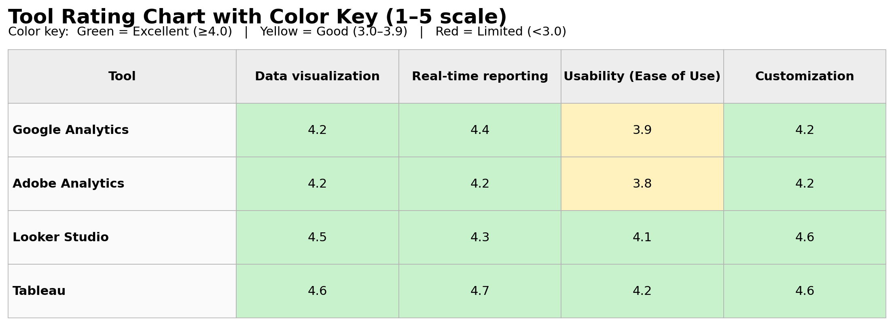
Tool Rating Chart with Color Key
Criteria used: data visualization, real-time reporting, usability, customization
Color key : Green = Excellent, 4-5, Yellow = Good 3-4, Red = 0-3
Score scale: 1 to 5
Notes:
For this chart, we did not invent scores or rely on our own personal opinion. The ratings are based on publicly available third party review data, primarily from G2 comparison pages, which aggregate thousands of verified user reviews across analytics platforms.
G2 reports feature scores on a 0–10 scale for categories such as:
Data visualization
Real time reporting
Ease of use
Customization and reporting flexibility
So, we divided by 2 made it a scale of 1-5.
Google Analytics 4 (GA4)
Data Visualization (4.2): Strong built-in charts and funnels, though less flexible than BI-first tools.
Real-Time Reporting (4.4): One of GA4’s strengths, with near real-time event streaming and live dashboards.
Usability (3.9): Learning curve is steeper due to the event-based model and redesigned interface.
Customization (4.2): Good customization through explorations and BigQuery exports, but limited UI flexibility.
Overall: Very strong analytics engine with some usability trade-offs.
Adobe Analytics
Data Visualization (4.2): Highly capable visual analysis tools within Analysis Workspace.
Real-Time Reporting (4.2): Solid real-time capabilities, though often requires configuration.
Usability (3.8): Powerful but complex; typically requires trained analysts.
Customization (4.2): Extremely flexible segmentation and reporting for enterprise use cases.
Overall: Enterprise-grade power, but complexity lowers ease of use.
Looker Studio
Data Visualization (4.5): Excellent dashboard visuals and layout flexibility.
Real-Time Reporting (4.3): Near real-time when connected to live data sources.
Usability (4.1): More intuitive than enterprise tools, especially for non-technical users.
Customization (4.6): Very strong customization through calculated fields and connectors.
Overall: Best balance of flexibility and usability for dashboards and reporting.
Tableau
Data Visualization (4.6): Industry leader in visual analytics and exploratory analysis.
Real-Time Reporting (4.7): Strong live connections and real-time data refresh capabilities.
Usability (4.2): Powerful but requires some learning; more intuitive than Adobe for most users.
Customization (4.6): Highly customizable visuals, calculations, and dashboards.
Overall: Best-in-class visualization and analysis, especially for data exploration.
Source I used: https://www.g2.com/

Slide 15

Data Use Policies Companies Should Adopt
Purpose limitation: collect data only for defined business needs
Data minimization: avoid collecting unnecessary personal details
Retention rules: keep data only as long as needed
Access control: limit who can view or export sensitive data
Notes:
Now that we have seen how analytics tools compare, it is just as important to talk about how the data inside those tools should be handled. Strong analytics without clear data use policies can quickly create legal, ethical, and trust issues. Companies need to be deliberate about why data is collected, limit collection to what is actually needed, and avoid holding onto personal data longer than necessary. Access controls matter because analytics exports can expose sensitive behavior if shared too broadly. Clear policies protect users, but they also protect the business by reducing risk and maintaining credibility with customers and regulators.

Slide 16
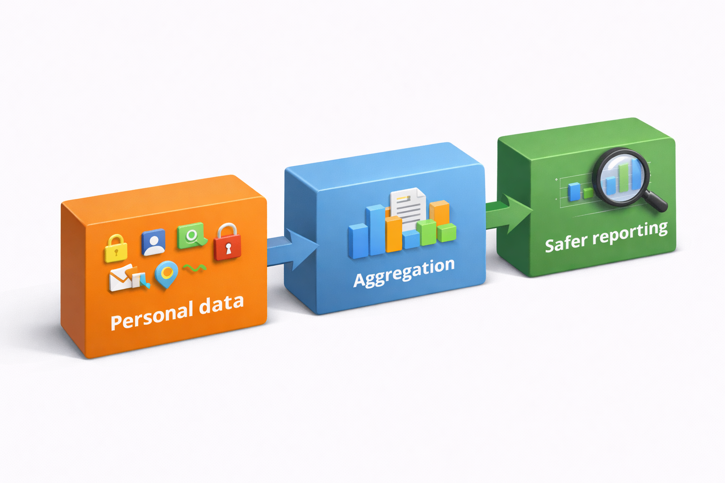
Responsible Use of Personal Data and Aggregated Data
Use consent where required and respect opt-out choices
Prefer aggregated reporting for trend decisions
Remove identifiers when they are not needed
Audit vendors and integrations for compliance alignment
Notes:
Building on data use policies, this is how responsible use looks in practice. The default should always be aggregated reporting, especially when making trend or performance decisions. Individual-level data should only be used when there is a clear business reason and proper consent in place. Removing identifiers reduces risk without reducing insight. Vendor and integration audits matter because third-party tools can quietly expand data sharing beyond what teams expect. Responsible data handling is not just compliance-driven, it directly supports safer reporting and long-term trust.

Slide 17

Data Ownership and Transparent Practices
Explain what data is collected and how it is used
Clarify who owns first-party data and how it is governed
Document metric definitions so reports stay consistent
Support user rights and clear request workflows
Notes:
Once data is collected and used responsibly, ownership and transparency becomes very important. Teams need to be clear about what data they collect, how it is used, and who is accountable for it. Defining ownership helps prevent confusion when questions arise about accuracy, access, or retention. Consistent metric definitions keep reports aligned across teams so decisions are based on the same understanding. Transparency also supports user rights by making data requests, corrections, and opt-outs easier to manage. Clear ownership ultimately builds trust both internally and with users.

Slide 18

Q&A (1/2)
Q: What is the difference between a metric and a KPI?
A: A KPI is a metric tied directly to a business goal and a decision
Q: Why do two tools show different numbers for the same period?
A: Definitions, attribution rules, sampling, filters, and tagging differences
Notes:
This slide is part of the 2 slide Q&A. These are two that are very common. The first is the difference between a metric and a KPI. A metric is anything we can measure, but a KPI is selected because it directly supports a business goal and drives a decision. The second question is why two tools can report different numbers for the same period. In most cases, the data itself is not wrong. The differences come from how each tool defines sessions and events, applies attribution rules, filters traffic, or handles sampling. Understanding those definitions matters more than chasing a single number.

Slide 19
Q&A (2/2)
Q: How do you avoid misleading charts?
A: Use consistent scales, label units clearly, and sanity check totals
Q: How do you know whether a metric is actually trustworthy?
A: Validate it by checking definitions, comparing it across tools or reports, and confirming it behaves logically over time.
Notes:
These questions help tie everything together from the presentation. When we talk about avoiding misleading charts, consistency is only part of the solution. Sanity checking means stepping back and asking whether the numbers actually make sense in context.
A sanity check is a quick reality test. For example, if revenue suddenly doubles but there was no campaign change, no seasonality shift, and no pricing update, that should raise a flag. If conversion counts are higher than total sessions, or engagement jumps overnight with no clear reason, those are signals to pause and investigate.
The second question reinforces data trust. A metric becomes trustworthy when it is clearly defined, behaves logically over time, and aligns with related metrics across tools or reports. When teams do this consistently, they avoid making decisions based on reporting errors instead of real performance.

Slide 20

Contact Information
Kevin McMahon
Email: kevin.mcmahon@smail.rasmussen.edu
Notes:
That brings everything together. We covered how analytics data is collected, processed, modeled, and ultimately turned into decisions, along with the risks that come from poor definitions, misleading visuals, or unclear ownership.
The key takeaway is that good analytics is not about collecting more data. It is about collecting the right data, validating it, and using it responsibly so teams can trust what they see and act on it with confidence.
I included my contact information for follow-up questions.

Slide 21

References
Shahid, M. (2024, October 8). What is web analytics and why it matters for your business. Usermaven. https://usermaven.com/blog/what-is-web-analytics Usermaven
RisingWave. (2024, October 9). Understanding web analytics: Key benefits and use cases. RisingWave. https://risingwave.com/blog/understanding-web-analytics-key-benefits-and-use-cases/ RisingWave
Web analytics overview. (n.d.). ScienceDirect Topics. https://www.sciencedirect.com/topics/computer-science/web-analytics ScienceDirect
Statsig. (2024, February 15). What is the importance of web analytics?. Statsig Perspectives. https://www.statsig.com/perspectives/what-is-the-importance-of-web-analytics Statsig
Kuleto, V. (2023). Privacy and ethics in web analytics: Balancing user data protection and insight generation. International Journal of Business and Management and Marketing. https://ijbmm.com/paper/Sep2023/8340436493.pdf ijbmm.com
Matomo. (2025, June 13). Privacy-friendly analytics: The benefits of GDPR-compliant analytics platforms. Matomo Blog. https://matomo.org/blog/2025/06/privacy-friendly-analytics/ matomo.org
Pilton, C. (2021). Determining user privacy expectations on the web. Digital Investigation. https://www.sciencedirect.com/science/article/pii/S0167404821000651 ****
COOKIEYES. (2025, August 11). What are the ethical considerations of cookie tracking? COOKIEYES Blog. https://www.cookieyes.com/blog/cookie-tracking-ethics/ ****
Wikipedia contributors. (2025, April). Data anonymization. In Wikipedia, The Free Encyclopedia. https://en.wikipedia.org/wiki/Data_anonymization ****
G2. (2025). Web analytics software comparisons. G2. https://www.g2.com/categories/web-analytics

